Slide 1
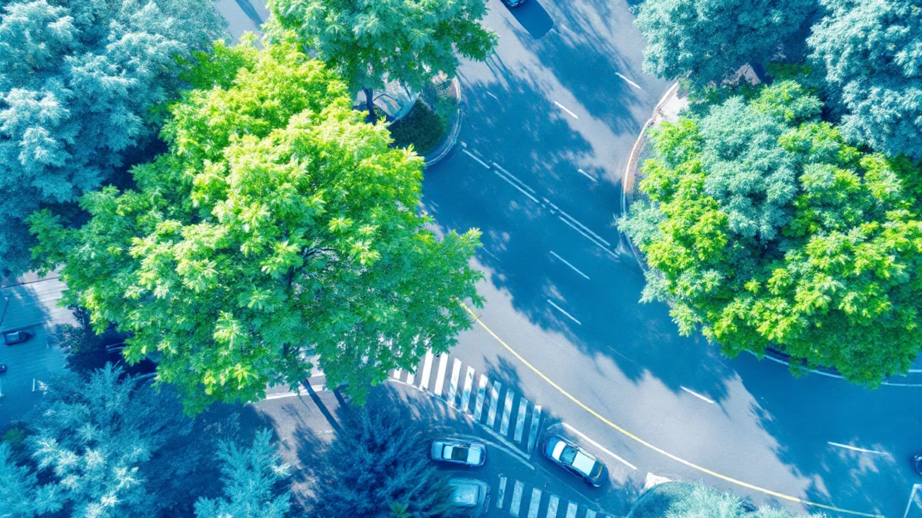

A Lightweight, Unsupervised Framework for Quantifying the Thermal Cooling Effect of Urban Tree Canopies from Street-Level Imagery
BCSE316L - Design of Smart Cities
Team members with contributions:
Devank Gupta (22BCE3295): Created the algorithm, worked on unsupervised model training for detecting thermal cooling effect, and created the report document.
Aayush Khanna (22BCE3240): Collected data from satellite imagery, extracted the complete dataset, and wrote the research paper.
Github link : https://github.com/devank21/Unsupervised-Framework-for-Quantifying-the-Thermal-Cooling-Effect
Under the Guidance of:
Dr. Swarnalatha. P
Notes:
1

Slide 2

Aim & Scope
AIM
The primary aim is to design, implement, and validate a lightweight, unsupervised computational framework capable of predicting the thermal cooling effect of tree canopies from standard RGB imagery.
SCOPE
Technical:
Geographical:
Temporal:
A proof-of-concept for an unsupervised computer vision pipeline using scikit-image and a custom Python thermal model. It explicitly does not involve deep learning or GPUs.
The framework is image-agnostic and geographically independent, designed to process any standard RGB image (street-level or aerial).
The project performs a static, "snapshot" analysis of a single image at one point in time. It is not designed for temporal forecasting.
Notes:
2

Slide 3
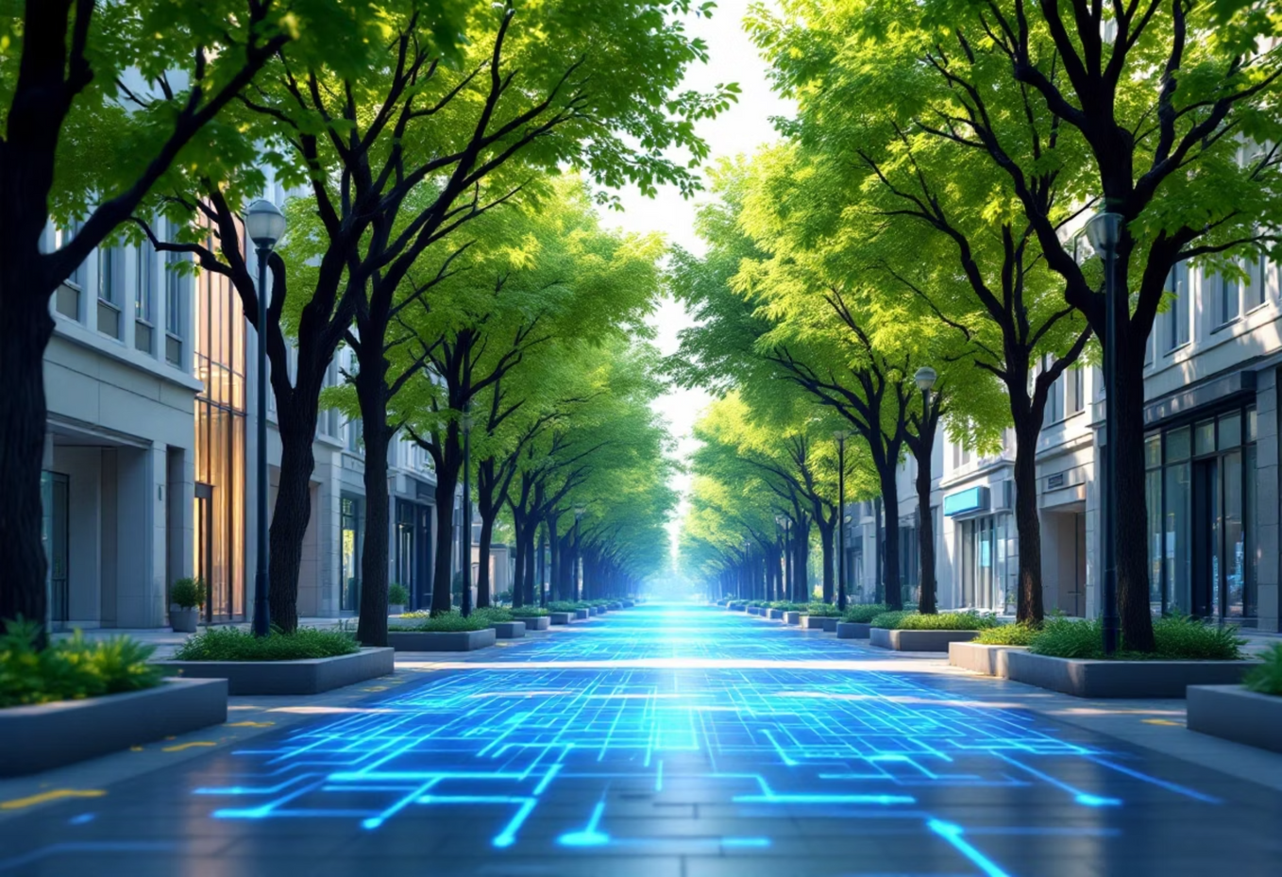
Abstract
The Urban Heat Island (UHI) effect poses a critical threat to urban sustainability. Green infrastructure, especially trees, is a primary mitigation strategy, but planners lack scalable tools to quantify their cooling performance.
While deep learning models exist, they are computationally expensive and require large, labeled datasets.
This project presents a novel, lightweight computational framework using an unsupervised computer vision approach.
Methodology:
01
02
03
Segmentation
Modeling
Visualization
Uses SLIC (Simple Linear Iterative Clustering) superpixels and a VARI (vegetation index) filter.
Applies a physics-based model to calculate a predicted temperature drop (ΔT) for each canopy based on its size and health.
Generates a virtual thermal map.
This framework provides a computationally efficient, scalable, and interpretable alternative, producing quantitative cooling estimates (in °C) to enable data-driven urban planning.
Notes:
3

Slide 4

Objectives
1
To implement an unsupervised segmentation pipeline:
2
To develop a quantitative thermal model:
Create a physics-based model that calculates a predicted temperature drop (ΔT) for each segmented canopy, based on its relative size and health (mean VARI score).
Use SLIC superpixels and a VARI filter to automatically identify and isolate tree canopies without manual labeling.
3
To create a visualization module:
4
To provide actionable data:
Generate intuitive, human-readable outputs, including a "Virtual Thermal Map" and an "Annotated" image labeling each tree with its predicted cooling value.
Output a structured table of statistics for each tree, detailing its size, health score, and predicted cooling.
Notes:
4

Slide 5

Hardware & Software Requirements
Hardware Requirements:
Software Requirements:
CPU: Intel Core i5/i7 (or equivalent)
Operating System: Windows / macOS / Linux
RAM: 8 GB or more
Development Environment: Google Colab / Jupyter Notebook
Language: Python 3.8+
Core Libraries: scikit-image, OpenCV-Python, NumPy, Pandas, Matplotlib
Notes:
5

Slide 6
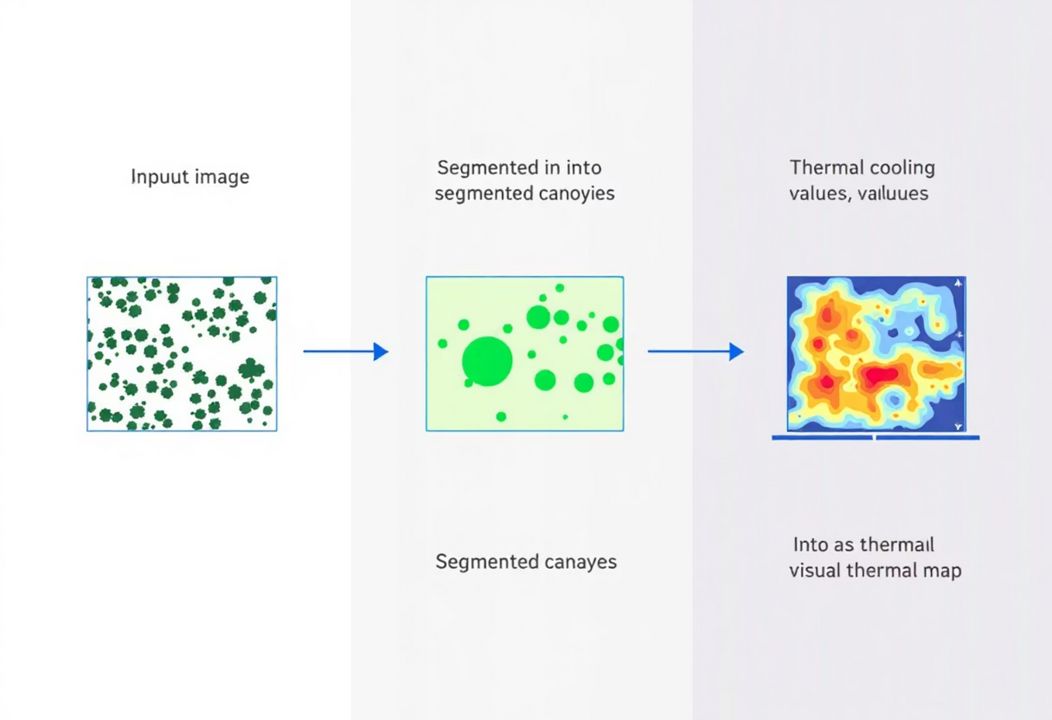
Methodology (Overview)
The system is a three-stage, feed-forward pipeline based on unsupervised analysis.
It is a "white box" design, where each stage and parameter is explicit and interpretable.
Stage 1: Segmentation (Where are the canopies?)
Stage 2: Modeling (How much do they cool?)
Stage 3: Visualization (How can we use this?)
Uses the SLIC algorithm to cluster pixels into superpixels (considers color and spatial proximity).
Applies a simple thermal model: Cooling is a function of Health (proxied by VARI) and Size (proxied by pixel area).
Translates raw data into human-readable formats.
Generates a qualitative "virtual thermal map" and quantitative per-object data.
Filters superpixels based on average VARI (health) score and size to isolate "large, green objects."
Computes a quantitative, interpretable cooling value (ΔT) for each tree.
Notes:
6

Slide 7
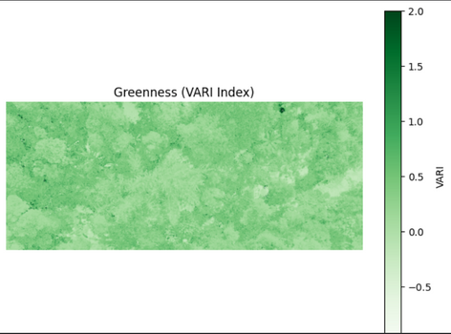
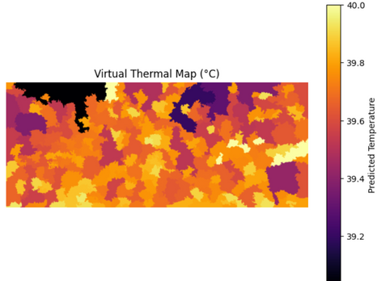
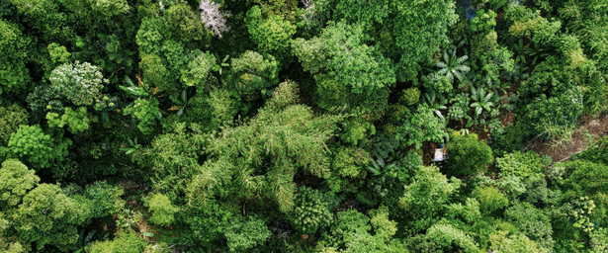
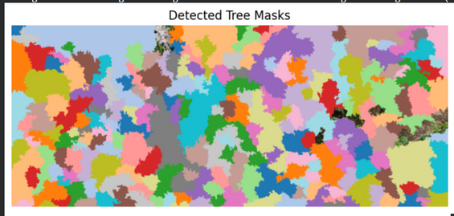
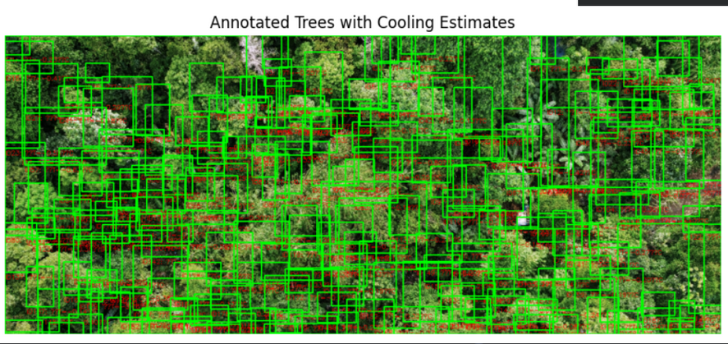
Demonstration of a real example thorugh the project implementation

Slide 8

Methodology (Block Diagram of the System)
Sub-process 2.1: Apply Cooling Model
Input: Input Image
Raw image from sensor
Simulate temperature effects
Process 2.0: build_virtual_thermal_map
Process 1.0: extract_tree_masks
System Data Flow
Estimate thermal values
Isolate tree regions
Sub-process 1.2: compute_vari
Sub-process 1.1: segmentation.slic
Variance-based features
Superpixel segmentation
Notes:
7

Slide 9
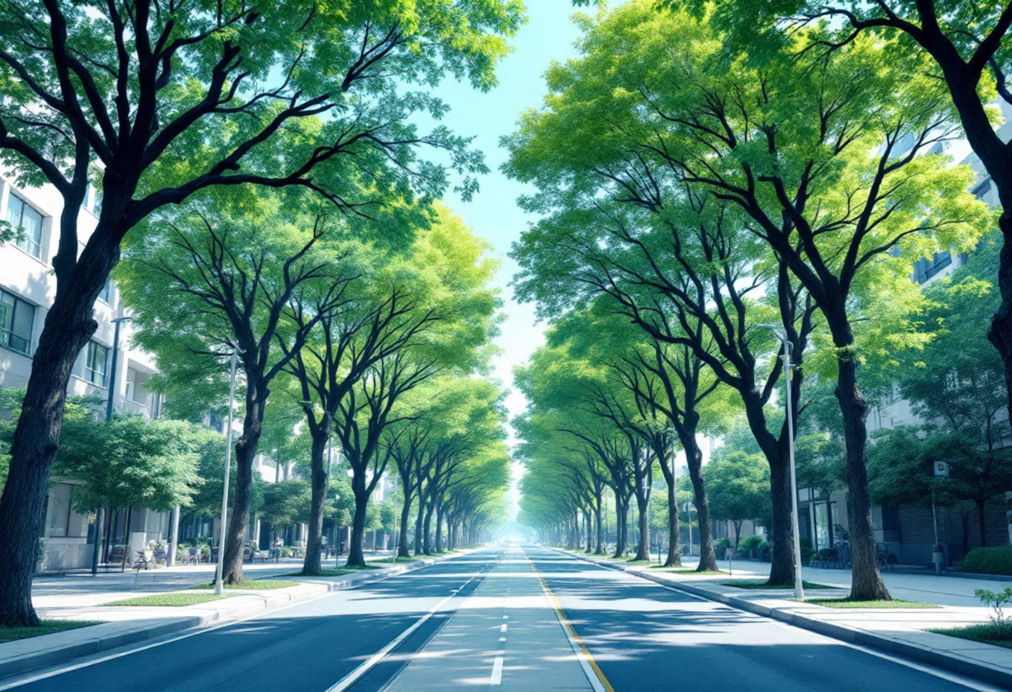
Detected Tree Masks (Output of Stage 1)
Discussion Points:
This image shows the output of the extract_tree_masks function.
Each contiguous, colored patch represents an individual superpixel that has passed the VARI (greenness) and area thresholds.
This demonstrates the algorithm's ability to partition a complex, heterogeneous canopy into its constituent parts, forming the basis for per-object analysis.
Notes:
8

Slide 10

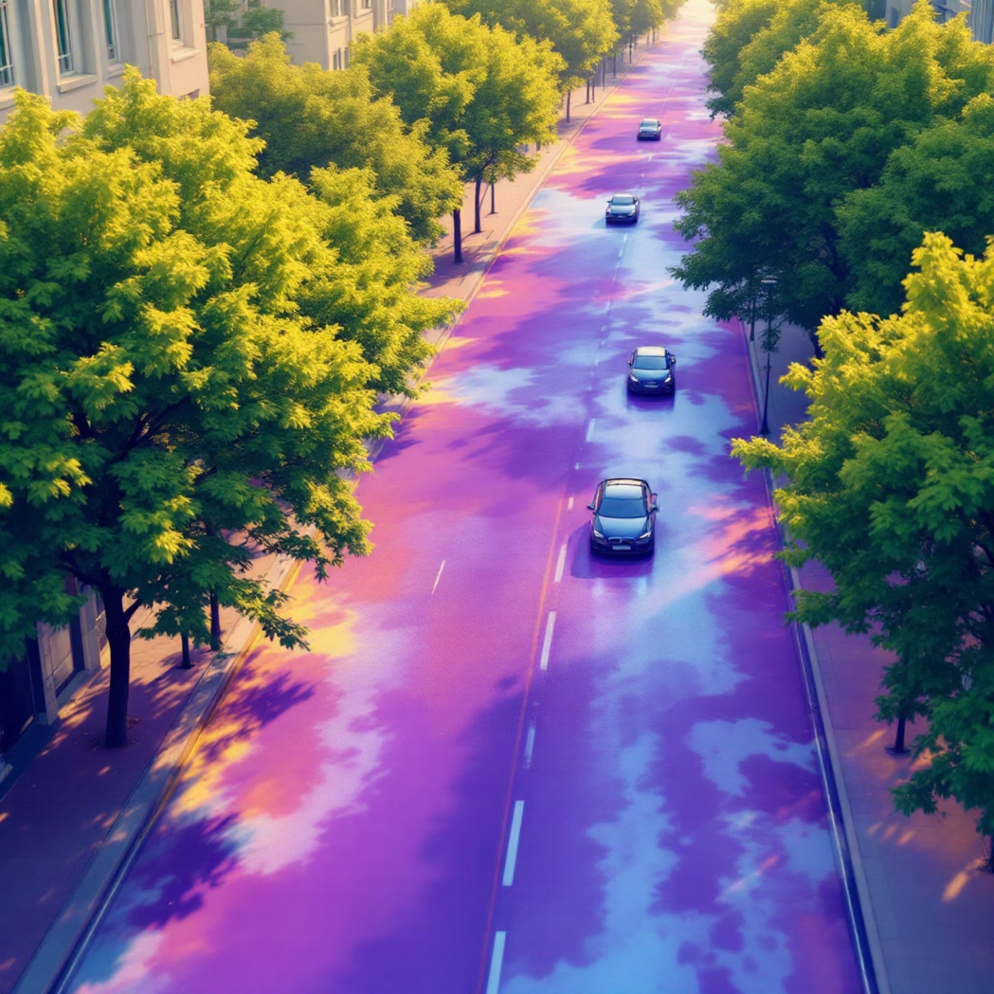
Results: Stage 2 - Health & Thermal Model
Figure 6.2: Greenness (VARI Index) Map
Figure 6.3: Virtual Thermal Map (°C)
Serves as the "health" input for the model.
The key predictive output of the framework.
Bright green areas show high positive VARI scores, indicating healthy vegetation.
Assuming a base ambient temperature of 40.0°C, the map shows the cooling effect.
Used to filter segments in Stage 1 and calculate the cooling factor in Stage 2.
Dark purple regions correlate with high-VARI areas and represent the coolest parts, dropping to ~39.1°C.
Notes:
9

Slide 11
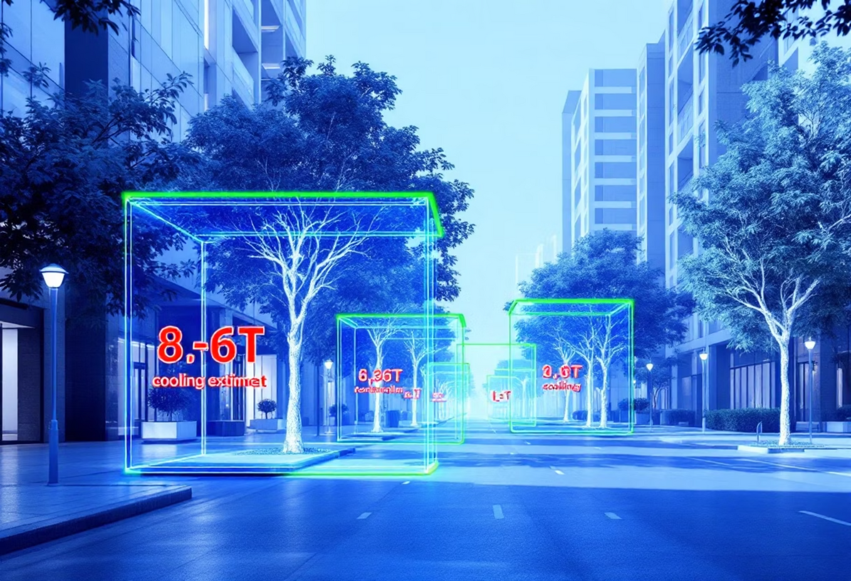
Results: Stage 3 - Quantitative Output
Table: Sample Quantitative Output for Detected Trees
id | area_px | mean_vari | est_cooling_C
1 | 68,210 | 0.31 | -2.85
2 | 12,450 | 0.23 | -0.98
Discussion Points:
Green bounding boxes are drawn around each individual canopy.
Red text shows the quantitative cooling estimate (ΔT) for that specific canopy, as calculated by the thermal model.
...
...
...
...
Notes:
10

Slide 12


Conclusion
Successfully designed and validated a lightweight, unsupervised framework to predict the thermal cooling impact of urban tree canopies from RGB imagery.
The framework innovatively combines SLIC superpixel segmentation, VARI-based health analysis, and a physics-based thermal model.
It provides quantitative, interpretable cooling estimates (ΔT in °C) for individual trees.
The key contribution is a scalable and accessible "white box" alternative to computationally expensive, data-hungry deep learning models.
This tool empowers urban planners with data to design greener, more resilient, and thermally comfortable smart cities.
Notes:
11

Slide 13




Future Work
Real-World Calibration:
3D Data Integration:
Parameter Automation:
The most critical next step. Involves using co-located thermal camera images to adjust the model's parameters (e.g., C_max, T_base) until its predictions match real-world measurements.
The current model uses 2D pixel area. A future version could integrate 3D data (from LiDAR or smartphone scanning) to use canopy volume, providing a more accurate input for the shading model.
Investigate methods to automatically estimate optimal parameters (like n_segments and vari_thresh) based on image properties (e.g., resolution, texture) to reduce manual tuning.
Notes:
12

Slide 14
References
Achanta, R., Shaji, A., Smith, K., et al. (2012). "SLIC Superpixels Compared to State-of-the-Art Superpixel Methods." IEEE Transactions on Pattern Analysis and Machine Intelligence.
Berland, A., et al. (2021). "Mapping trees along urban street networks with deep learning and street-level imagery." ISPRS Journal of Photogrammetry and Remote Sensing.
Cai, Y., Li, W., et al. (2018). "Treepedia 2.0: Applying Deep Learning for Large-Scale Quantification of Urban Tree Cover." KDD.
Gitelson, A. A., et al. (2002). "Vegetation and Soil Lines in Visible Spectral Space: A Concept and Technique for Remote Estimation of Vegetation Fraction." International Journal of Remote Sensing.
Harlan, S. L., et al. (2006). "Neighborhood microclimates and vulnerability to heat stress." Social Science & Medicine.
McPherson, E. G., et al. (1994). "Chicago's urban forest ecosystem." General Technical Report NE-186, U.S. Department of Agriculture.
Oke, T. R. (1982). "The energetic basis of the urban heat island." Quarterly Journal of the Royal Meteorological Society.
Santamouris, P. (2014). "Cooling the cities – A review of reflective and green roof mitigation technologies." Solar Energy.
Seiferling, I., Naik, N., Ratti, C., & Proulx, R. (2017). "Green streets − Quantifying and mapping urban trees with street-level imagery and computer vision." Landscape and Urban Planning.
Notes:
13

Slide 15







Slide 16


Project Outcome: Paper submitted for publication

